Slide 1
Privacy-Preserving Multicast to Explicit Agnostic Destinations
Cuong Ngoc Tran cuongtran@mnm-team.org
Vitalian Danciu danciu@mnm-team.org

Slide 2
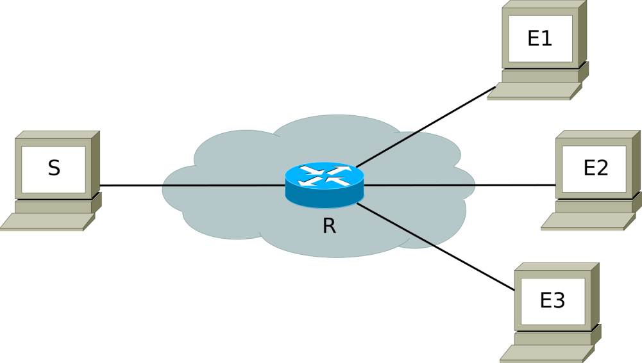
Large-scale distribution of content
Unicast:
Inefficient use of
transmission resource/channel
Multicast:
Complicated management
Usage initiation requires
management intervention
Join/leave
Sender
Sender
Routers
Routers
Receiving
End-points
Receiving
End-points
Notes:
Revise the animation of the packet.

Slide 3
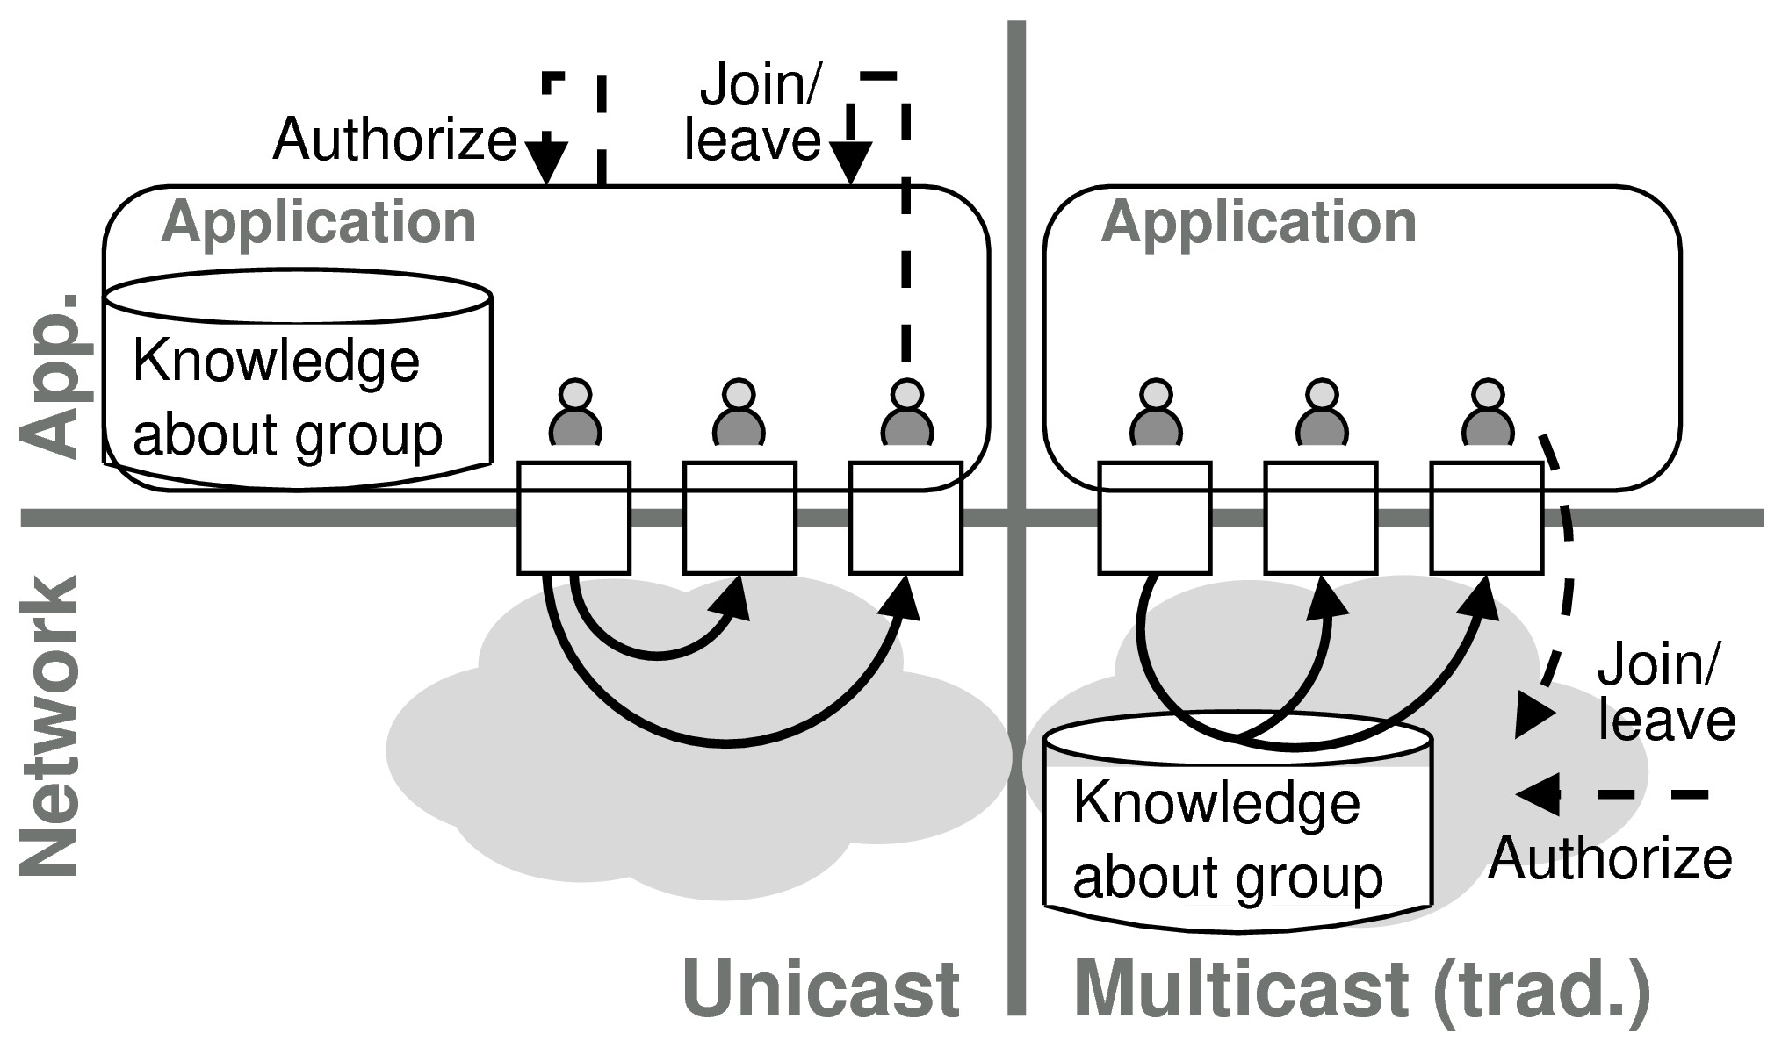
Knowledge distribution and group management
Notes:
require network management to authorize a service session
require the user to execute a network management action
transfer knowledge of group membership on the application level to a multicast group
introduce state to the otherwise state-less IP communication
limited deployment, ALM is prefered
ALM:
Multicast function is moved to application layer
Require receiver-side configuration
Does not profit from network support
Xcast:
multicast with explicit unicast addresses
efficient data delivery with network support
gradual deployment by using ALM but with high-latency data delivery
Support max. 64 participants

Slide 4

Approach
https://www.lifehack.org/articles/lifestyle/10-the-best-mead-recipes.html

Slide 5
Approach
Multicast to Explicit Agnostic Destinations (MEADcast)
“Slow start” of multiple unicast
Discover network support
Consolidate unicast stream into MEADcast where possible
All knowledge + management are at sender side, none at receiver
Notes:
One-to-many communication
Group management at sender
Agnostic receiving end-point
Stateless data delivery at router
Privacy amongst receiving end-points
Efficient data delivery with support from network, otherwise unicast
Support for gradual deployment
Support a large number of participants

Slide 6
MEADcast functions
Topology discovery
  Sender discovers MEADcast-aware routers (MEADcast router) on all paths towards receiving end-points
Data delivery
  Sender transmits data based on the discovered topology
Notes:
R 0 does not drop the message since the option type identifier of MEADcast header is 00 [10].

Slide 7
MEADcast header
MEADcast header
(IPv6 extension header)
IPv6 header
S |E1
R1 | E1 | E2 | R2 | E3 | E4
Address list
1 | 0 | 0 | 1 | 0 | 0
Router-map
1 | 0 | 0 | 1 | 0 | 0
Bitmap
Address list : contains IPv6 addresses of receivers and delivering routers
Router-map : marks the position of routers in the address list (bit = 1)
Bitmap : marks if a router still waits for MEADcast message (bit = 1)

Slide 8
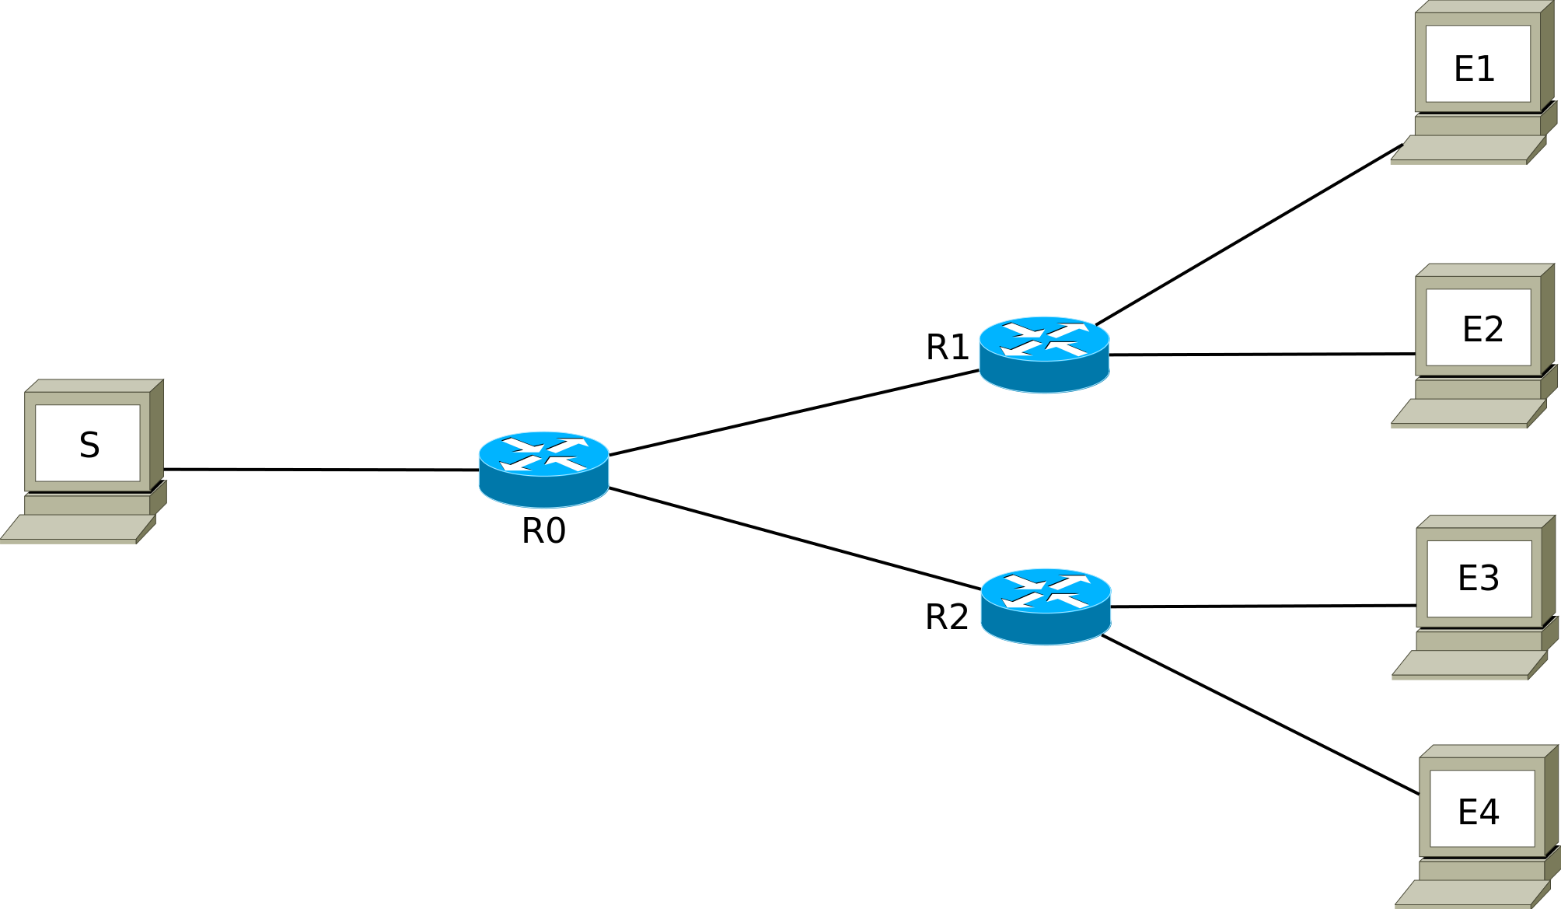
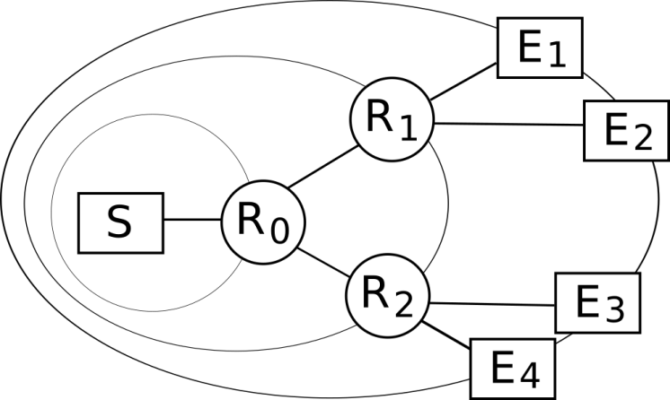
Data delivery :
All MEADcast network
IPv6 header
MEADcast header
(IPv6 extension header)
S |E1
R1 |E1|E2|R2|E3|E4
R1 |E1|E2
S |E1
S |E1
1 | 0 | 0 | 1 | 0 | 0
1 | 0 | 0
1 | 0 | 0 | 1 | 0 | 0
1 | 0 | 0
S |E2
S |E3
Sender’s viewpoint
S |E3
R2 |E3|E4
1 | 0 | 0
1 | 0 | 0
S |E4

Slide 9
Topology Discovery:
All MEADcast network
3. Receiver drops
discovery request
2. MEADcast Router:
+ sends discovery response,
+ forwards discovery request
1. Sender sends
discovery requests
MEADcast Router
4. Sender composes
topology based on
discovery responses

Slide 10

Topology Discovery:
All MEADcast network
Disc. Resp
# hop = 2, E1, R1
Disc. Req
# hop = 0, E1
Disc. Req
# hop = 0, E2
Disc. Req
# hop = 2, E1
Disc. Req
# hop = 1, E1
Disc. Resp
# hop = 2, E2, R1
Disc. Req
# hop = 0, E3
Disc. Req
# hop = 0, E4
Disc. Req
# hop = 1, E2
Disc. Req
# hop = 2, E2
Disc. Resp
# hop = 1, E3, R0
Disc. Req
# hop = 2, E3
Disc. Resp
# hop = 1, E1, R0
Disc. Req
# hop = 1, E3
Disc. Resp
# hop = 1, E4, R0
Disc. Resp
# hop = 2, E3, R2
Disc. Resp
# hop = 1, E2, R0
Disc. Req
# hop = 1, E4
Disc. Req
# hop = 2, E4
Disc. Resp
# hop = 2, E4, R2

Slide 11
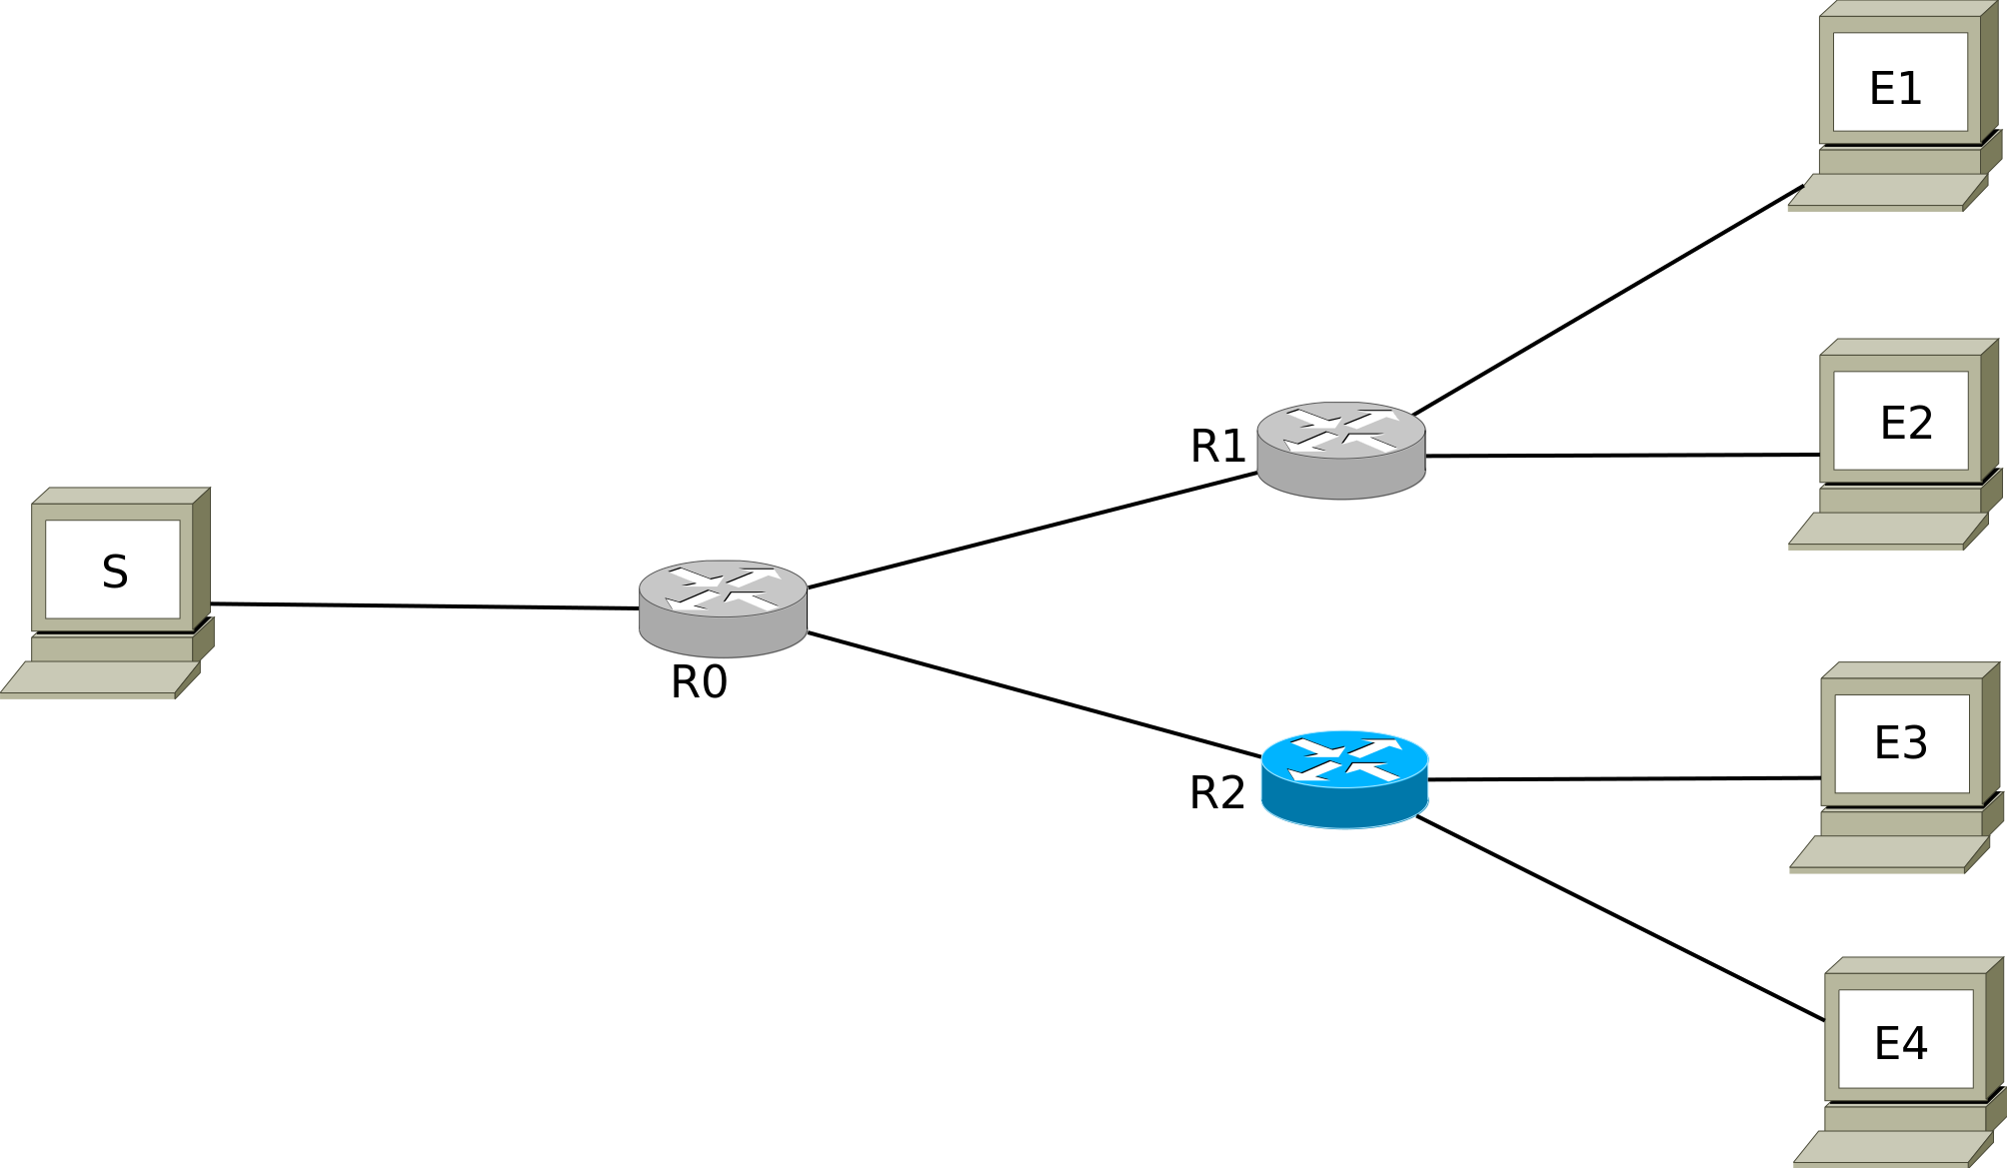
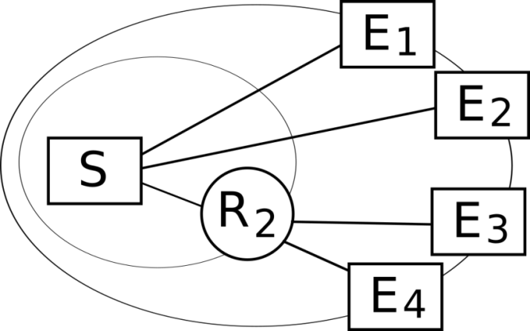
Topology Discovery:
Sparse MEADcast network
3. Receiver drops
discovery request
2. MEADcast Router:
+ sends discovery response,
+ forwards discovery request
1. Sender sends
discovery requests
Normal Router
MEADcast Router
4. Sender composes
topology based on
discovery responses

Slide 12
Disc. Req
# hop = 0, E1
Disc. Req
# hop = 0, E1
Disc. Req
# hop = 0, E1
Disc. Req
# hop = 0, E2
Disc. Req
# hop = 0, E2
Disc. Req
# hop = 0, E2
Disc. Req
# hop = 0, E3
Disc. Req
# hop = 1, E3
Disc. Req
# hop = 0, E3
Disc. Req
# hop = 0, E4
Disc. Resp
# hop = 1, E3, R2
Disc. Req
# hop = 0, E4
Disc. Req
# hop = 1, E4
Disc. Resp
# hop = 1, E4, R2

Slide 13

Data delivery:
Sparse MEADcast network
S |E1
S |E2
S |E1
S |E2
S |E3
S |E3
R2|E3|E4
1 | 0 | 0
1 | 0 | 0
S |E4
IPv6 header
MEADcast header
(IPv6 extension header)
Sender’s viewpoint

Slide 14
Relation to upper layers
Sender TCP/IP stack needs to be changed:
App
Application sends
group spec + add + delete
App
UDP
Transport
MEADcast
Network
IP
…
…

Slide 15
Overhead and Gain
The number of addresses in MEADcast header: 8, 16, 32, 64
Payload size
Maximum transmission unit
Overhead and fragmentation
Trade-off: multiplicity vs payload size
IP HEADER
MEADcast extension HEADER
Payload
fixed
variable
variable
MTU (fixed)

Slide 16
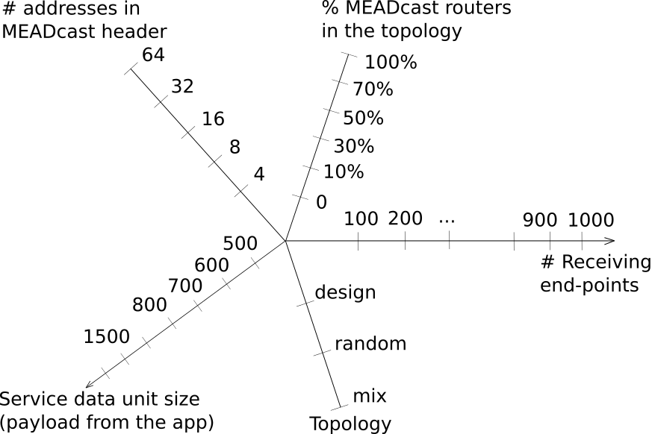
Study of efficiency

Slide 17
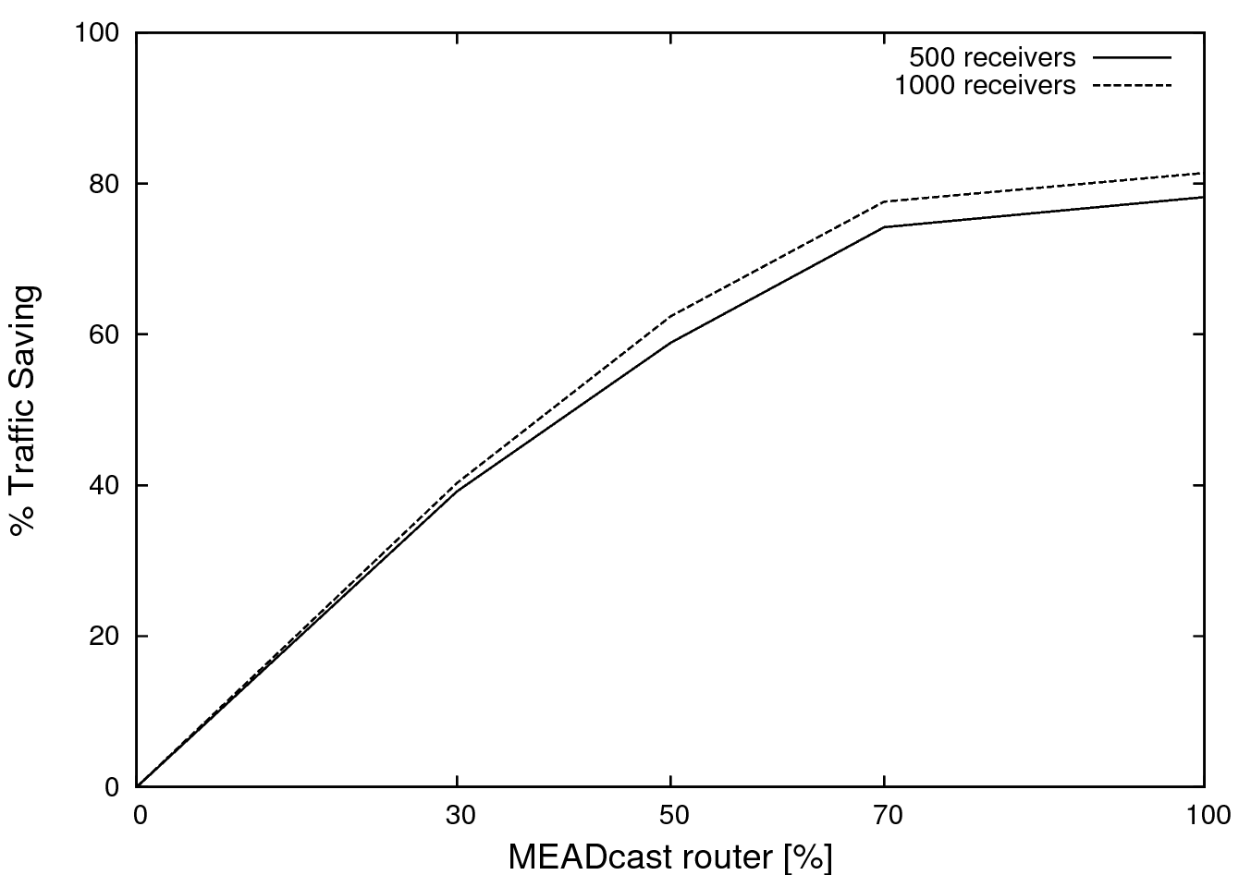
Traffic saving (vs. Unicast)

Slide 18
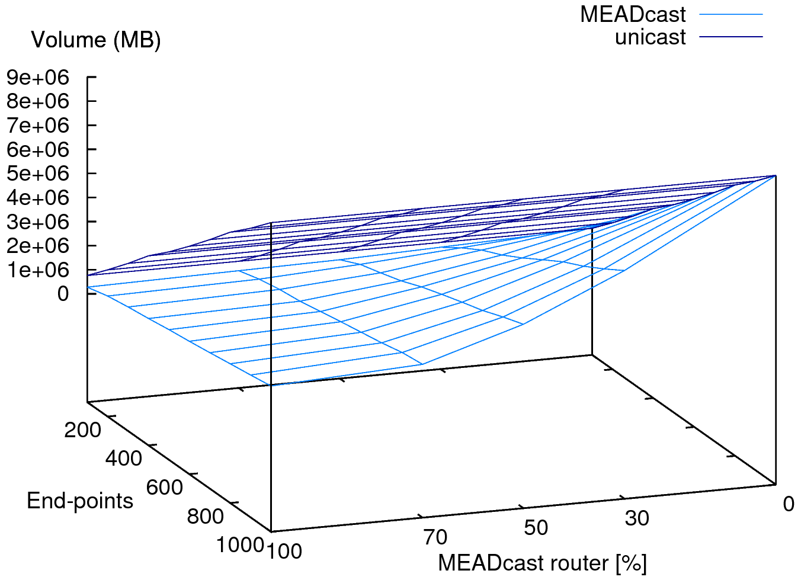
Result
% traffic saving
40%
62%
77%
81%
Total data volume in the whole network when sender transmits 800 MB data

Slide 19
Take-away
One-to-many communication
Group management at sender
Agnostic receiving end-point
Efficient data delivery with support from network, otherwise unicast
Stateless data delivery by MEADcast router
Support for gradual deployment
Support a large number of participants
MEADcast
cuongtran@mnm-team.org
danciu@mnm-team.org

Slide 20
Backup slides

Slide 21
Experiment setup
Number of addresses in MEADcast header: 8, 16, 32, 64
Percentage of MEADcast routers in the topology: 0, 10%, 30%, 50%, 70%, 100%
Number of receivers: 100, 200, 300 … 900, 1000
Topology: design, random, mix
Service data unit size (payload from the application layer): 500, 600, 700, 800, 900 … 1500

Slide 22
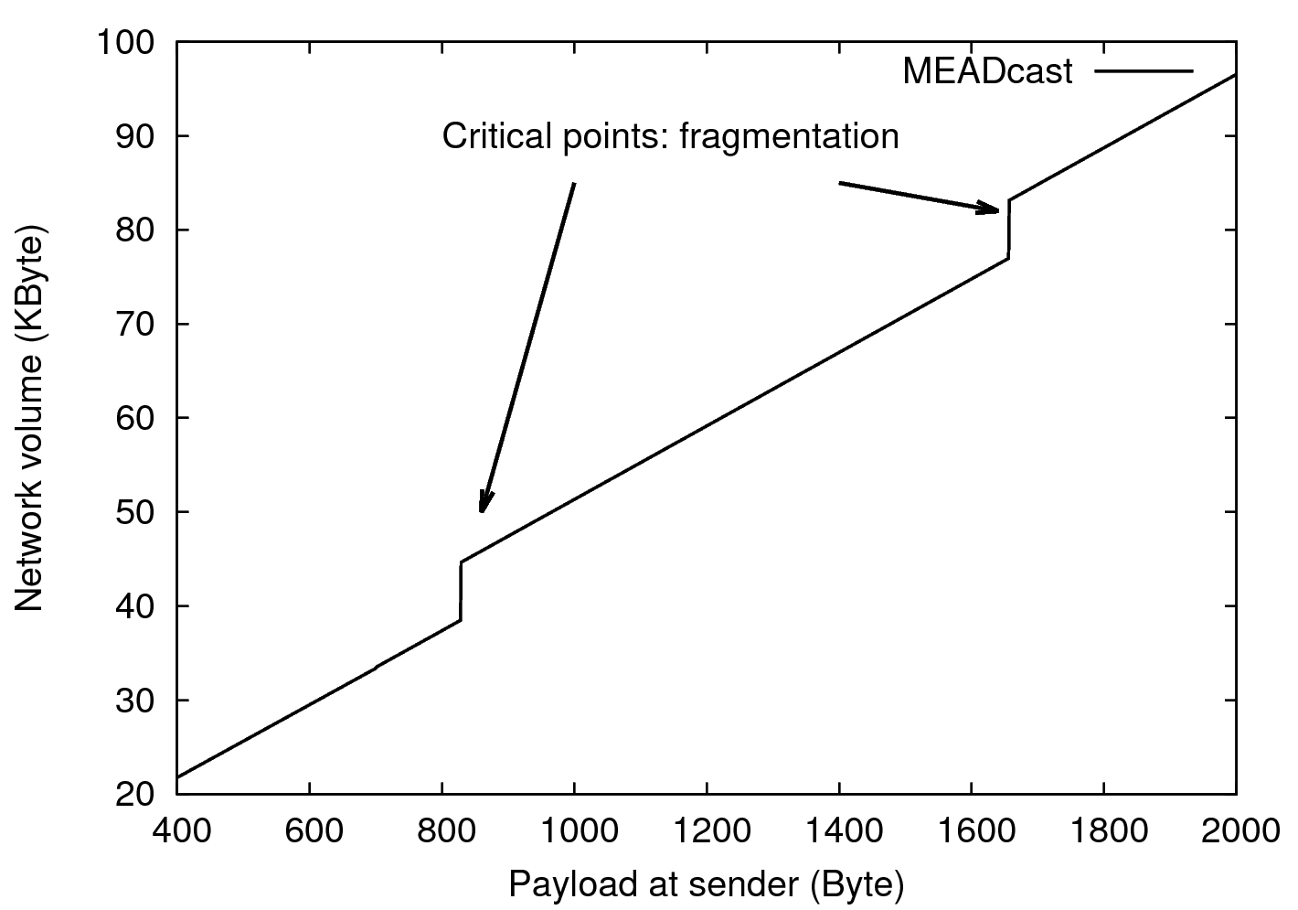
Fragmentation by payload

Slide 23
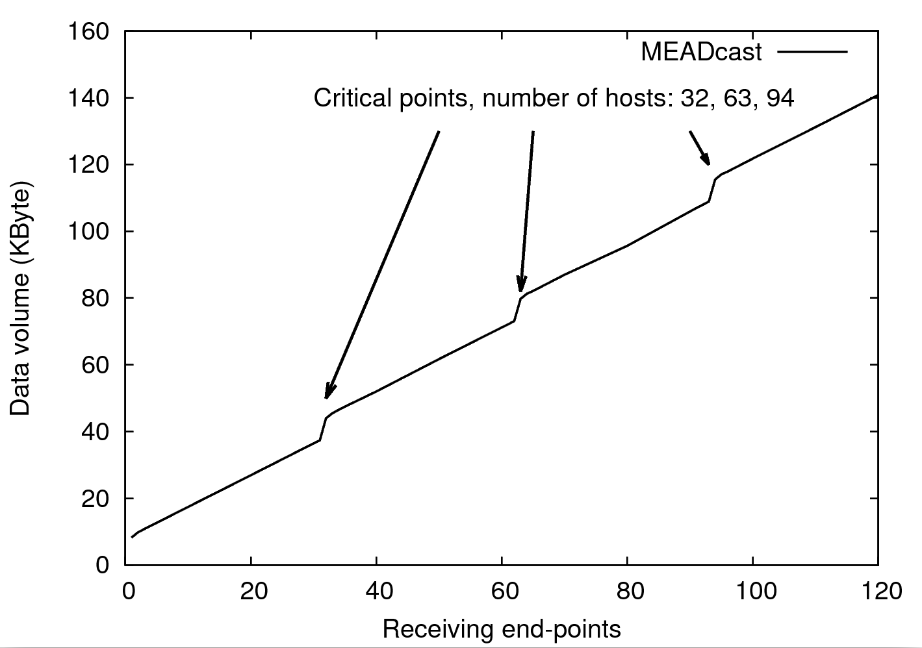
Fragmentation by # receivers

Slide 24
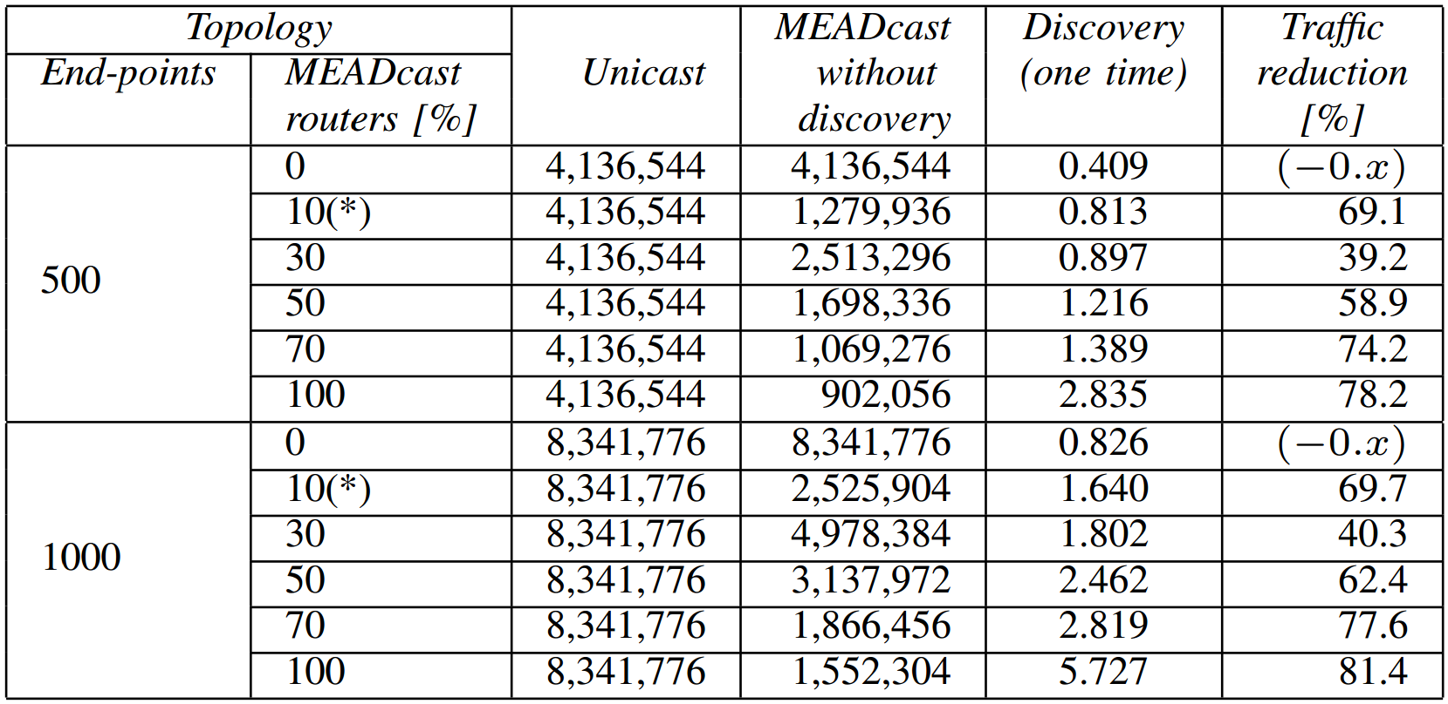
Evaluation
Total traffic volume in the whole network [mb] when sender transmits 800 MB data
(* indicates designed topology.)

Slide 25

Application Layer Multicast
Multicast function is moved to application layer
Require receiver-side configuration
Does not profit from network support
Some receivers maintain the other receivers’ identity → privacy issue
Sender
Routers
Receivers

Slide 26
Xcast (rfc5058)
multicast with explicit unicast addresses
efficient data delivery with network support
gradual deployment by using ALM but with high-latency data delivery
Support max. 64 participants
In gradual deployment, each receiver see the other receivers’ identity → privacy issue
Sender
Routers
Receivers
Notes:
support a very large number of small multicast sessions (each < 64 participants)

Slide 27
Compare to Multicast
TODO:
Show a scenario for multicast data delivery, similar to that of MEADcast. Point out what the sender, router and receivers have to do.
Compare to MEADcast

Slide 28
MEADcast header
Use bitmap and router-map to mark position of router in the MEADcast address list
A router whose address is in MEADcast header is responsible for all its continuous subsequent end-point addresses

Slide 29
Topology discovery
Sender rules for composing discovery:
Only MEADcast router which is responsible for at least two receiving end-points is put in MEADcast header, otherwise unicast
Farther router (higher hop count from sender) has higher priority to occupy a position in MEADcast header
If one MR sends discovery responses to sender with two different hop-counts, the response with larger hop count is eliminated in building the topology

Slide 30
Topology Discovery:
All MEADcast network
3. Receiver drops
discovery request
2. MEADcast Router:
+ sends discovery response,
+ forwards discovery request
1. Sender sends
discovery requests
MEADcast Router
4. Sender composes
topology based on
discovery responses

Slide 31
Topology Discovery:
All MEADcast network
Disc. Resp
# hop = 2, E1, R1
Disc. Req
# hop = 0, E1
Disc. Req
# hop = 0, E2
Disc. Req
# hop = 2, E1
Disc. Req
# hop = 1, E1
Disc. Resp
# hop = 2, E2, R1
Disc. Req
# hop = 0, E3
Disc. Req
# hop = 0, E4
Disc. Req
# hop = 1, E2
Disc. Req
# hop = 2, E2
Disc. Resp
# hop = 1, E1, R0
Disc. Req
# hop = 2, E3
Disc. Req
# hop = 1, E3
Disc. Resp
# hop = 1, E2, R0
Disc. Resp
# hop = 2, E3, R2
Disc. Req
# hop = 1, E4
Disc. Req
# hop = 2, E4
Disc. Resp
# hop = 1, E3, R0
Disc. Resp
# hop = 2, E4, R2
Disc. Resp
# hop = 1, E4, R0

Slide 32
Topology Discovery:
Sparse MEADcast network
3. Receiver drops
discovery request
2. MEADcast Router:
+ sends discovery response,
+ forwards discovery request
1. Sender sends
discovery requests
Normal Router
MEADcast Router
4. Sender composes
topology based on
discovery responses

Slide 33
Disc. Req
# hop = 0, E1
Disc. Req
# hop = 0, E1
Disc. Req
# hop = 0, E1
Disc. Req
# hop = 0, E2
Disc. Req
# hop = 0, E2
Disc. Req
# hop = 0, E2
Disc. Req
# hop = 0, E3
Disc. Req
# hop = 1, E3
Disc. Req
# hop = 0, E3
Disc. Req
# hop = 0, E4
Disc. Resp
# hop = 1, E3, R2
Disc. Req
# hop = 0, E4
Disc. Req
# hop = 1, E4
Disc. Resp
# hop = 1, E4, R2

Slide 34
Show a scenario of topology with cycle (loop)

Slide 35
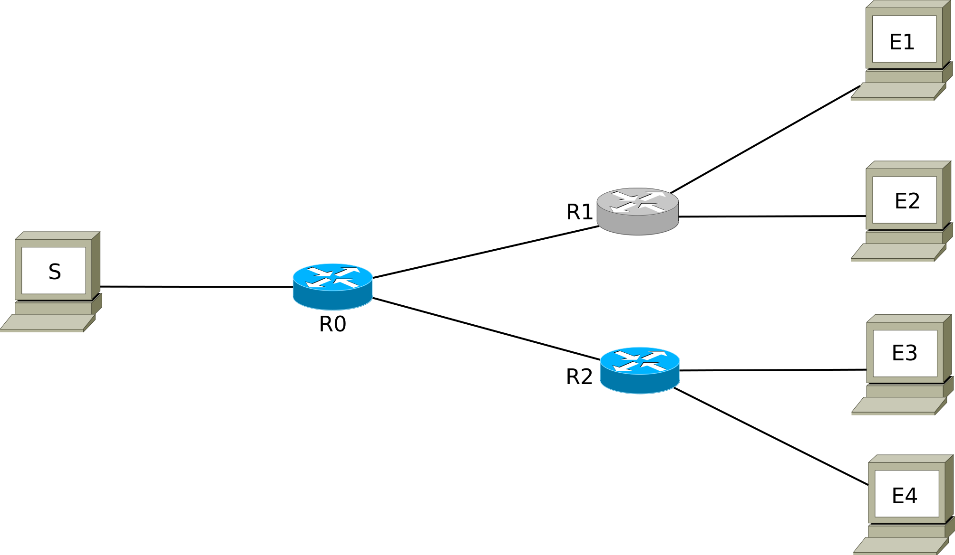
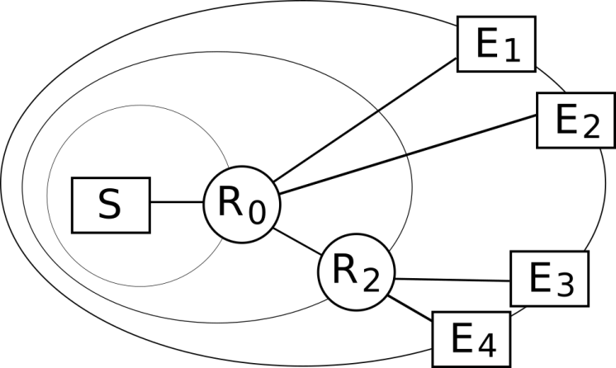
Example
S |E1
R0 |E1|E2|R2|E3|E4
1 | 0 | 0 | 1 | 0 | 0
S |E1
1 | 0 | 0 | 1 | 0 | 0
S |E2
S |E3
R2 |E3|E4
S |E3
1 | 0 | 0
1 | 0 | 0
S |E4

Slide 36
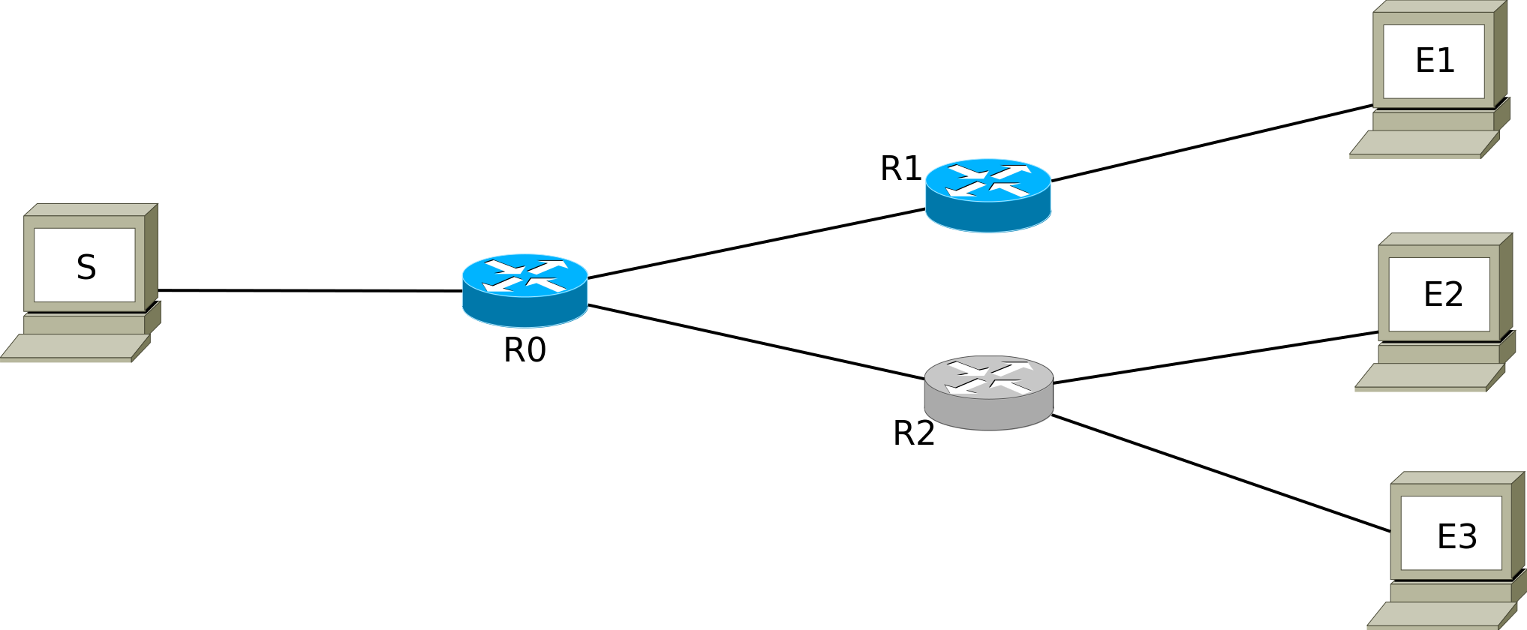
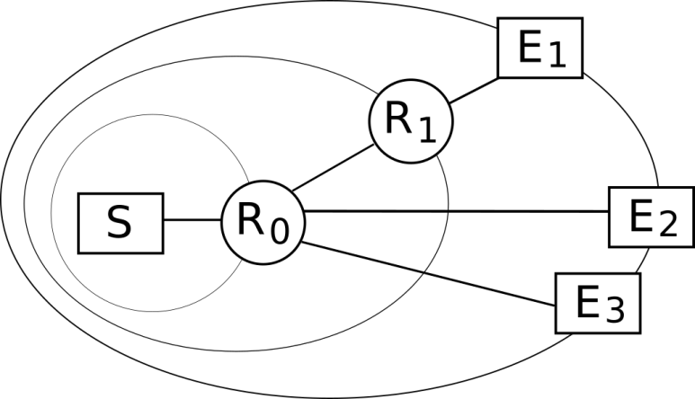
Example
S |E1
R1 |E1|E2|E3
1 | 0 | 0 | 0
1 | 0 | 0 | 0
S |E1
S |E2
S |E3

Slide 37
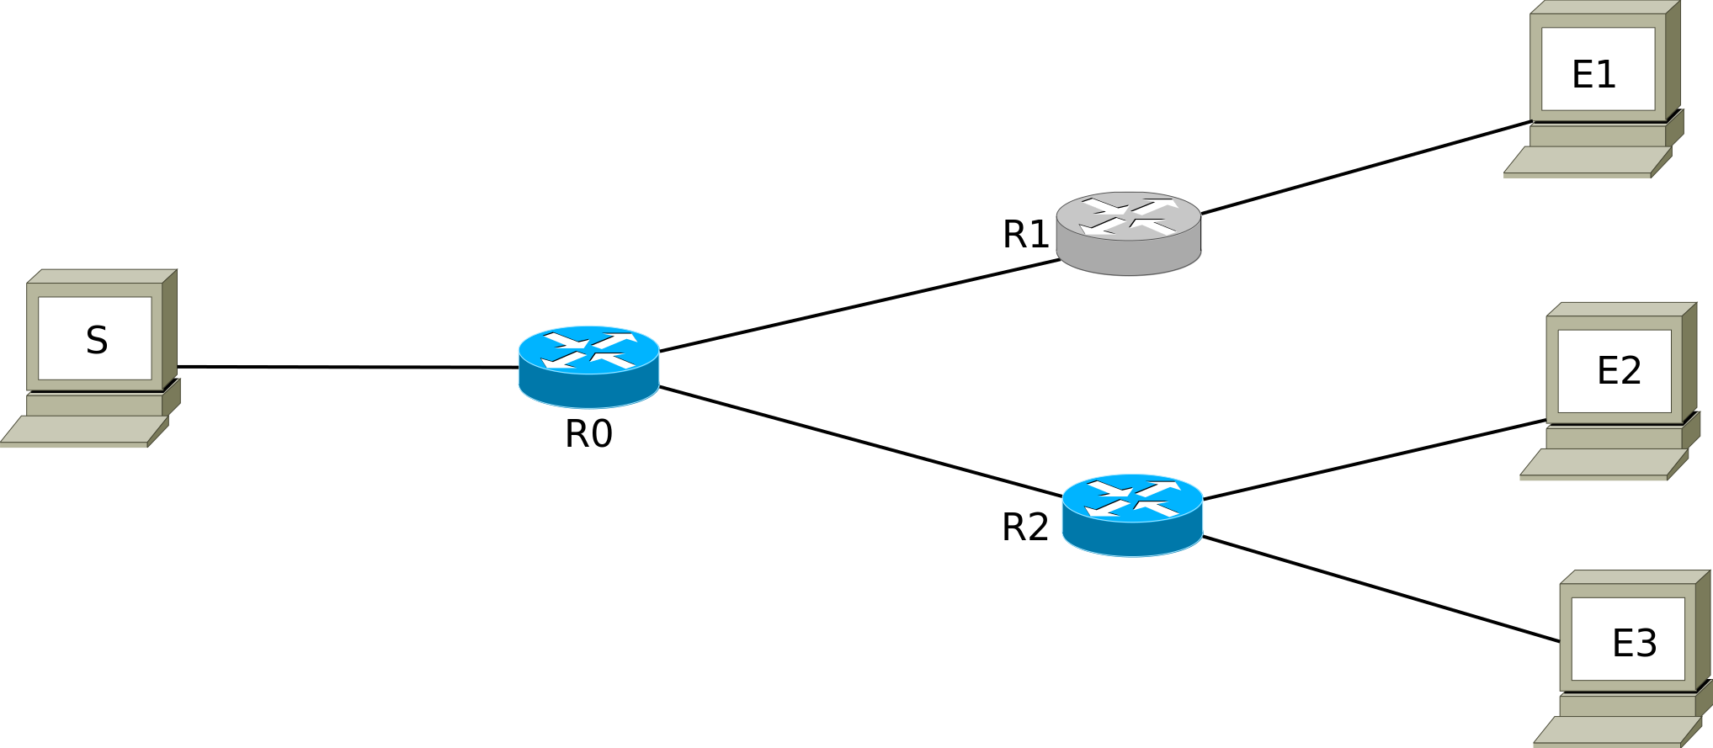
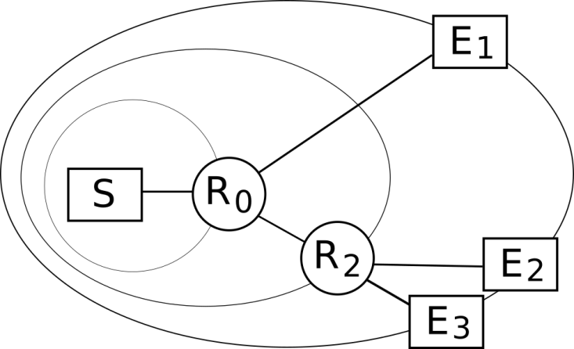
Example
S |E1
R0 |E1|R2|E2|E3
1 | 0 | 1 | 0 | 0
1 | 0 | 1 | 0 | 0
S |E1
S |E2
S |E2
R2 |E2|E3
1 | 0 | 0
1 | 0 | 0
S |E3

Slide 38
Example
However, if we don’t want an MEADcast router responsible for only 1 receiver
in MEADcast address list
S |E1
S |E1
S |E1
R2|E2|E3
S |E2
S |E2
R2 |E2|E3
1 | 0 | 0
1 | 0 | 0
1 | 0 | 0
1 | 0 | 0
S |E3

Slide 39
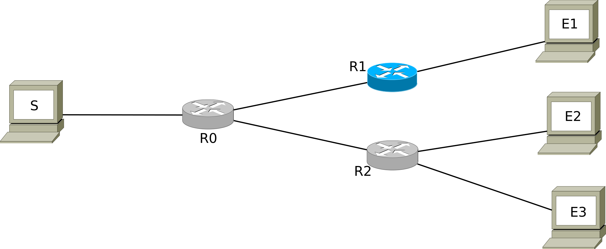
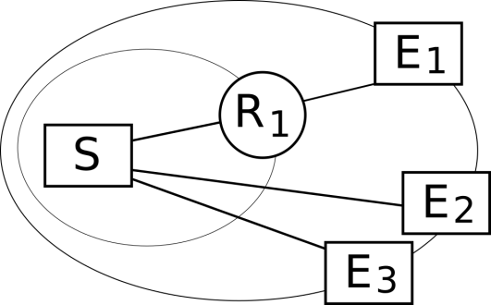
Example
S |E1
R1 |E1
S |E1
1 | 0
1 | 0
S |E2
S |E3

Slide 40
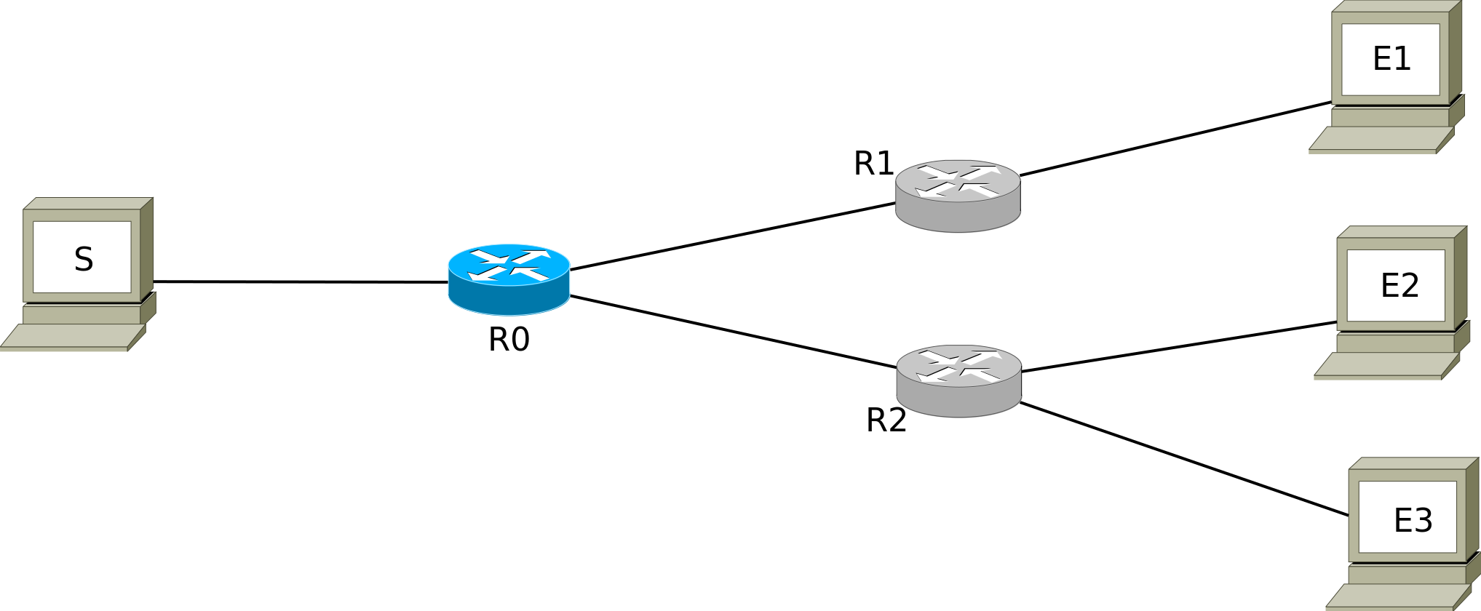
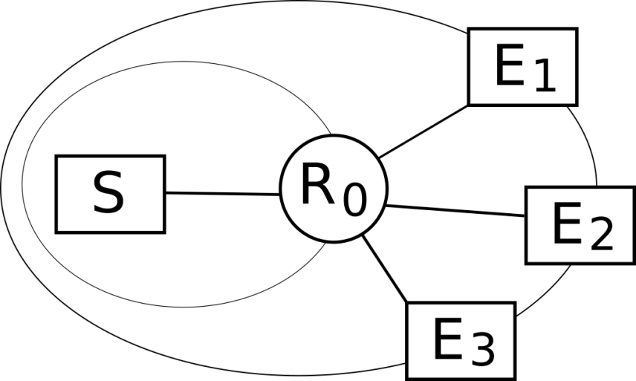
S |E1
R1 |E1|E2|E3
1 | 0 | 0 | 0
1 | 0 | 0 | 0
S |E1
S |E2
S |E3

